Slide 1






FLIGHT
PRICE PREDICTION
.........................................................

Slide 2
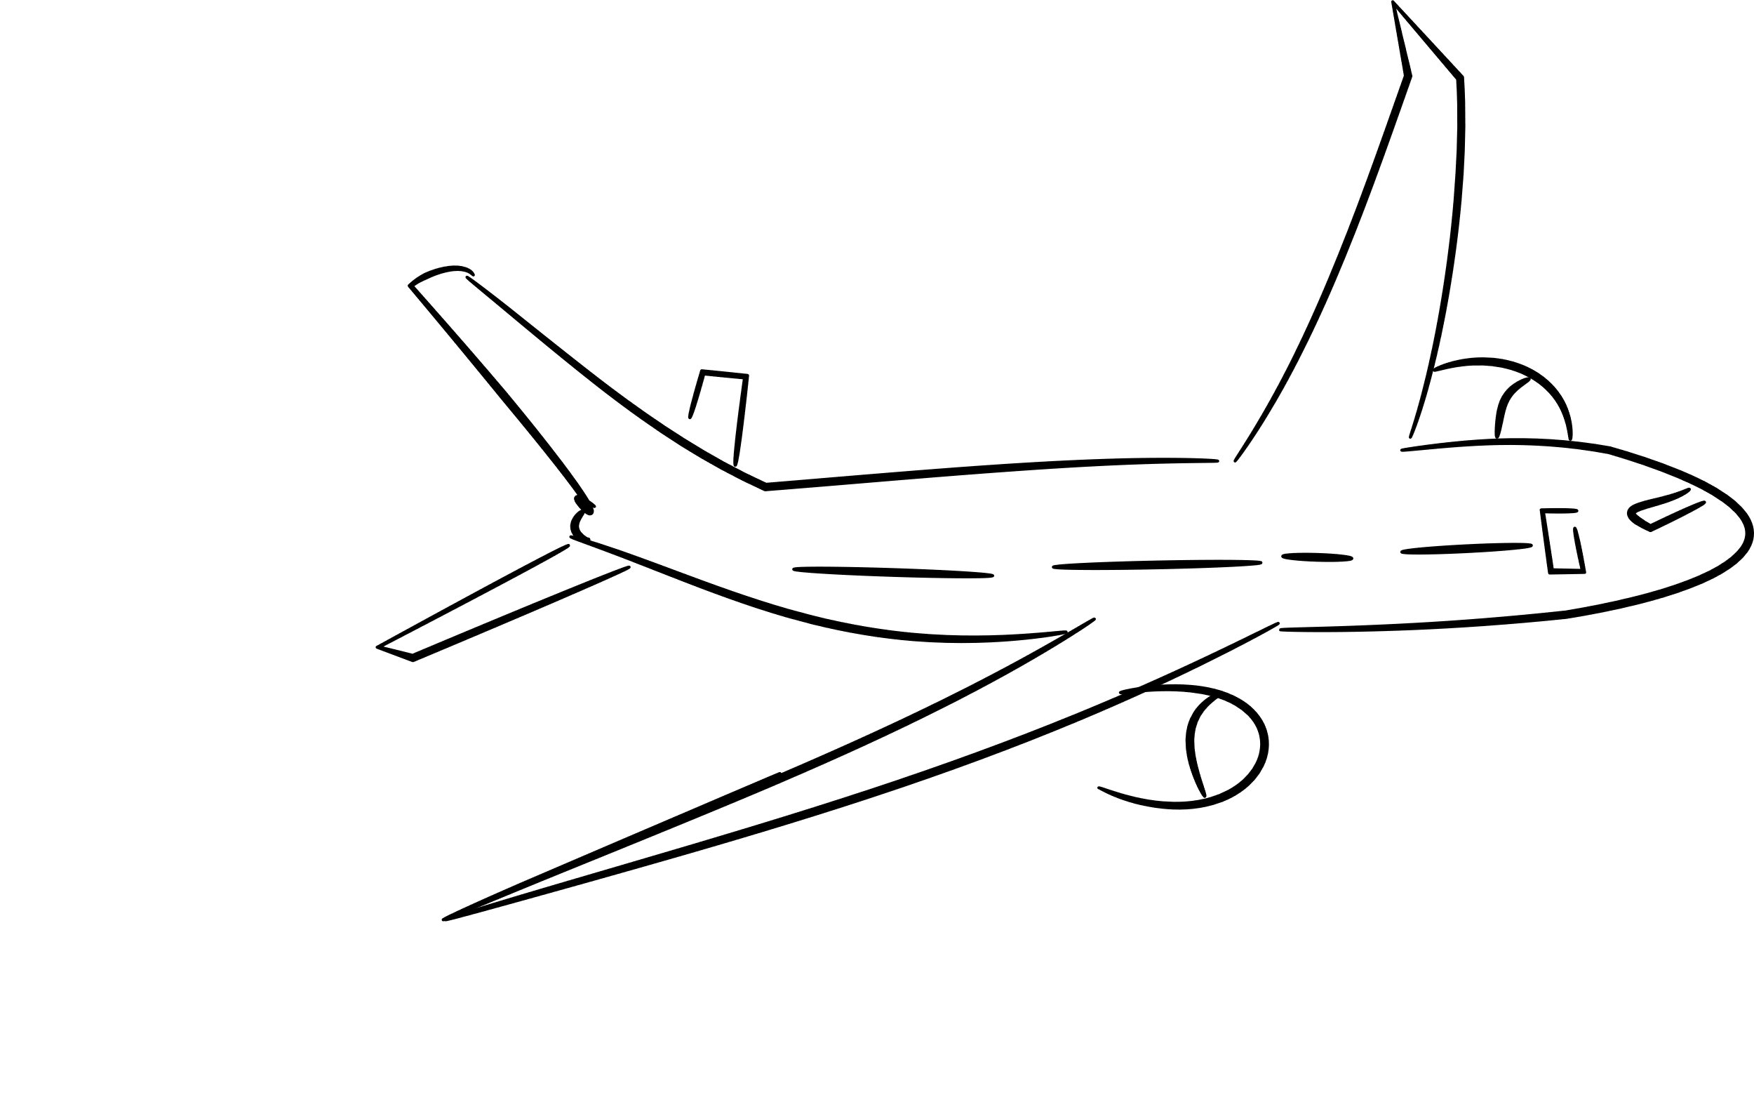




Problem Statement
Travelling through flights has become an integral part of today’s lifestyle ,as more and more people are opting for faster travelling options.
The flight ticket prices increase or decrease every now and then depending on various factors like timing of the flights, destination, duration of flights. various occasions such as vacations or festive season.
Therefore, having some basic idea of the flight fares before planning the trip will surely help many people save money and time. In practice, many travellers tend to purchase flight tickets as early as possible to avoid possible price hikes.
However, this type of purchase behavior does not always lead to the most economical flight tickets

Slide 3


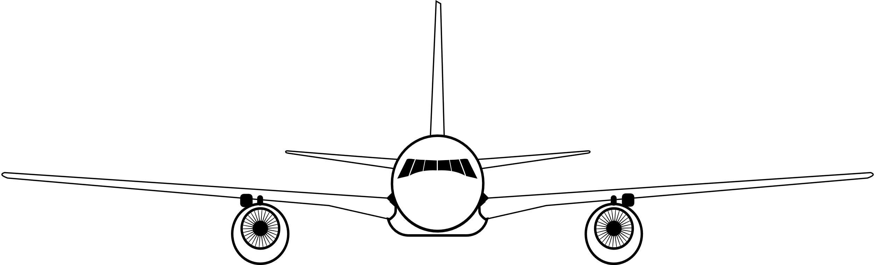



OBJECTIVES
01
This project aims to develop an application which will predict the flight prices for various flights using machine learning model.
02
The user will get the predicted values and with its reference, the user can decide to book their tickets accordingly

Slide 4




Technology Stack
HTML
JAVASCRIPT
MACINE LEARNING ALGORITHMS
JUPYTER NOTEBOOK
Web Server: XAMP

Slide 5

Proposed System
User Interface
Data Cleaning & Pre-Processing
Starting page content has been implemented, considering there is intuition with the help of JavaScript ,html and CSS . Frontend looks nice and warming for sighting
All the unnecessary data is removed like duplicates and null values. Various statistical techniques and logic builtin python are used to clean and prepare the data.
Algorithms Implemented
we have implemented many machine learning algorithm like Moving average, Extra Tree regressor and Random Forest.

Slide 6

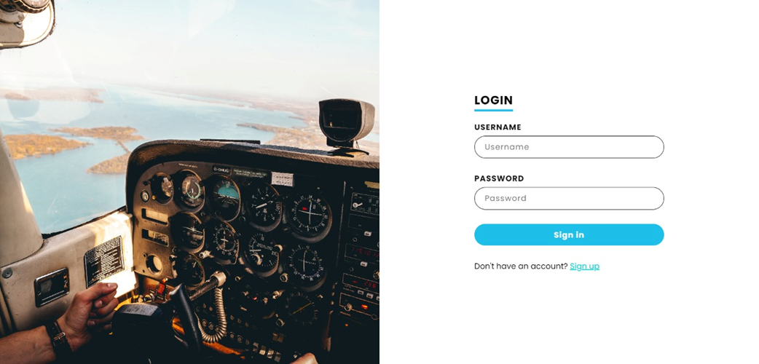

Screenshots

Slide 7
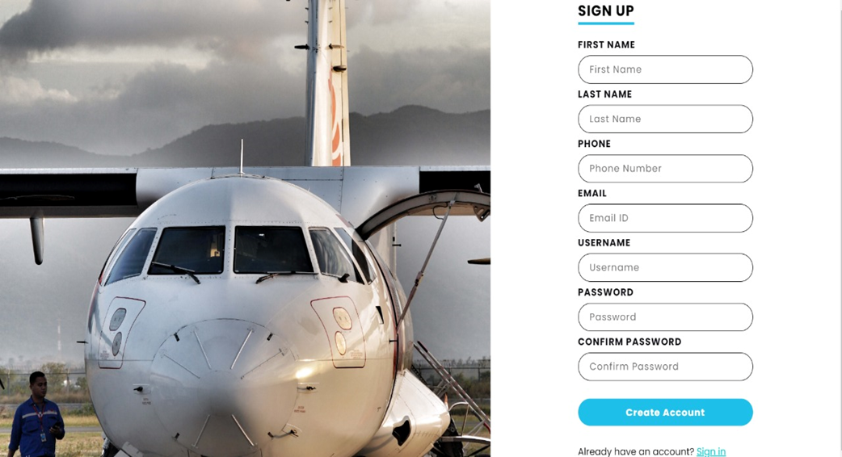
Screenshots

Slide 8
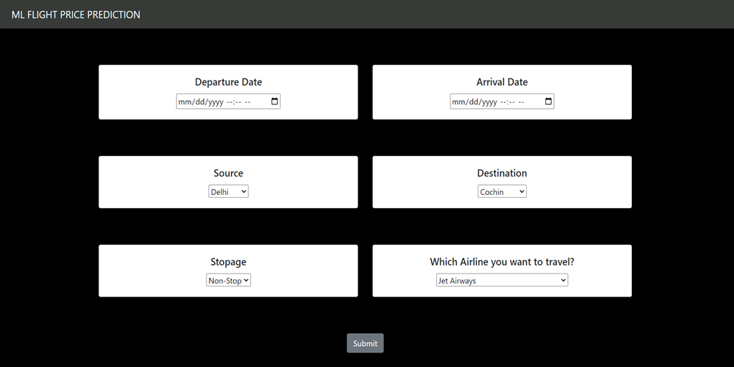
Screenshots

Slide 9




Thank You

